Slide 1
SCM PROJECT
Snake game
MEMBERS-
harshdeep(Leader)= Code Writing
Himanshu SIngh = PPT/Ideation
Himanshu sharma= implementation of libraries / Presentation

Slide 2
Details of Code
importing and installing – libraries
snake speed can be adjust by user
real time score calculation while playing
pre-defined keyboard controls

Slide 3
Details of code
install libraries; turtle, random,time .
- install libraries using pip cmd
-after that import main code using import function
create GUI and create a real time score calculating
firstly create a GUI will display number of eggs collected by snake
by collecting eggs ,snake starting becoming bigger and score increased

Slide 4
Details of code
To create a real time calculator which will add up the score in real time as the snake collects the eggs.
-As the Snake will collect eggs the points will add up by 10 and simultaneously.
-Not only will it keep the stats of score but it will also display the maximum score of the no. of times user has played the game.

Slide 5
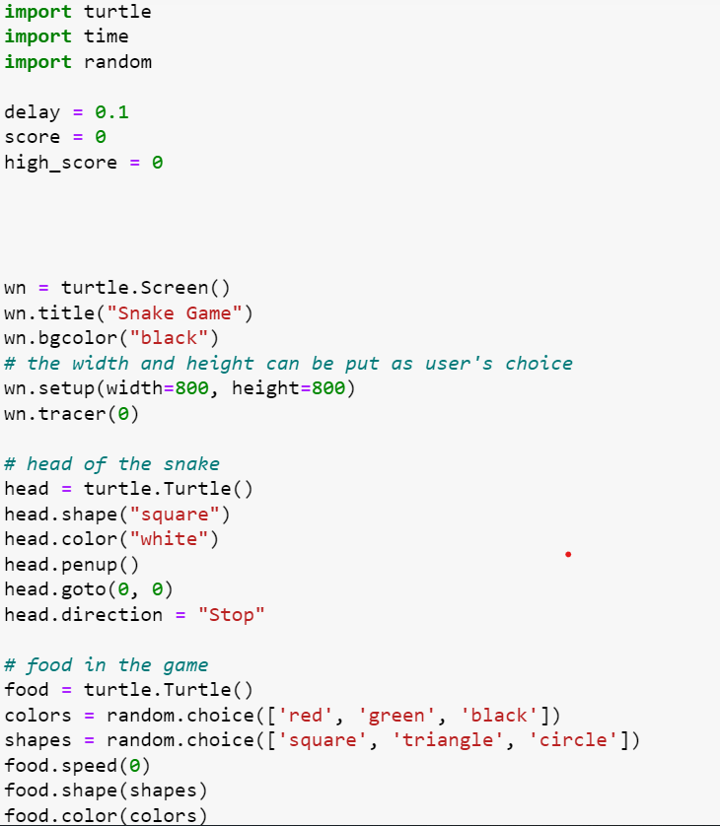
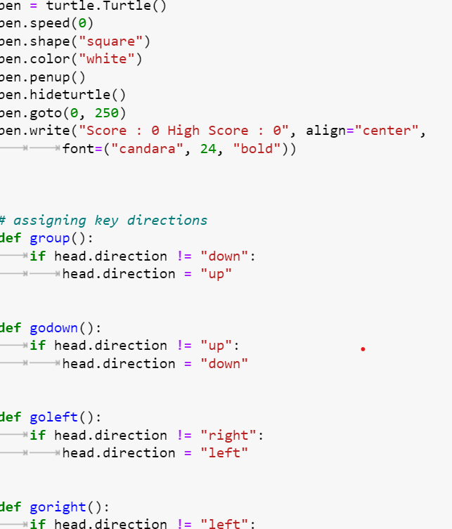
Code Screenshot

Slide 6
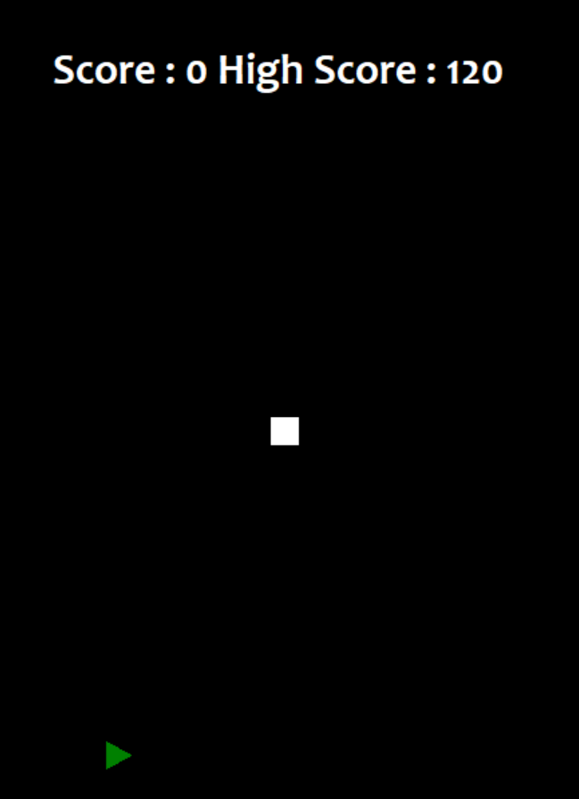
Output Screenshot
Output-Snake game

Slide 7
Group info
Harshdeep Singh/2210990383
Himanshu Sharma/2210990407
Himanshu Singh/2210990409

